Slide 1



Project on Analysis On You-tube Channels
By Salvapathi Naidu
&
Samya Puntikura

Slide 2

INTRODUCTION
YouTube is a global online video sharing and social media platform headquartered in California. It was launched on February 14, 2005, by Steve . It is owned by Google. YouTube has more than 2.5 billion monthly users who collectively watch more than one billion hours of videos each day. As of May 2019, videos were being uploaded at a rate of more than 500 hours of content per minute.
You tube has generated about 28.8 ($bn) Revenue in the year 2021 and About 2500+ millions of people use you-tube
YouTube has an estimated gross profit margin of ~38%
As implied by the category name,
cars and other vehicles Music.
Pets and Animals, Autos and Vehicles
Sports. ..
Travel & Events. ...
Gaming. ...
People and Blogs. ...
Comedy.

Slide 3
Problem Statement:
1.In the world of YouTube to find out which category tops the list and their respective Revenue Generated .
2.And which feature effects the growth of Revenue
3.Does the growth of Subscribers effect the views
4. And does category effect the increase the raise of No of Subscribers
and fall of No of Subscribers ?
5. What is the maximum and minimum Revenue of Generated by different Category
Revenue
Views
Subscribers
Category
Videos

Slide 4
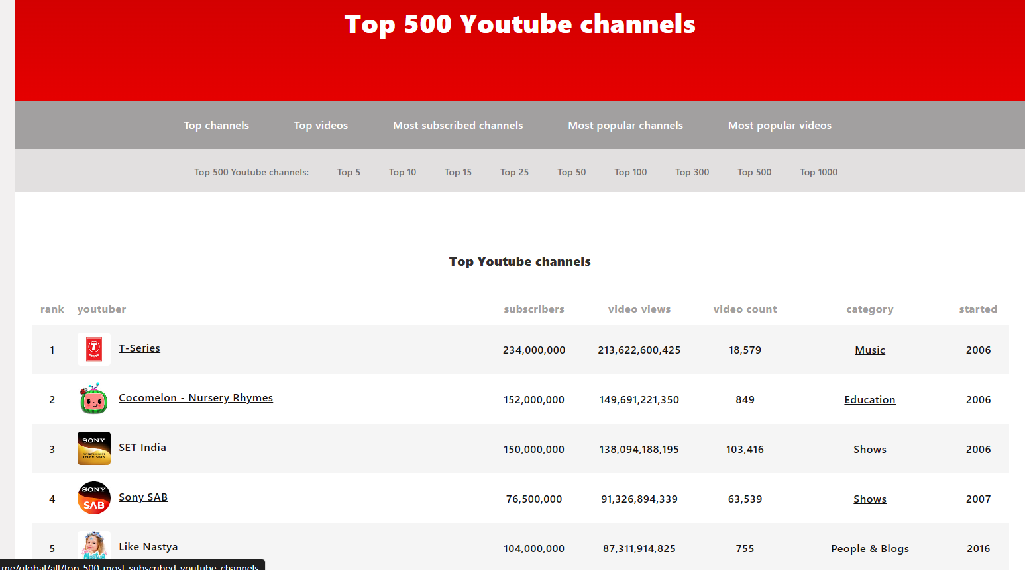
Web Scraping:
Web site:Top 500 YouTube channels (youtubers.me)
https://us.youtubers.me/global/all/top-500-youtube-channels
INTERFACE OF THE WEBSITE

Slide 5
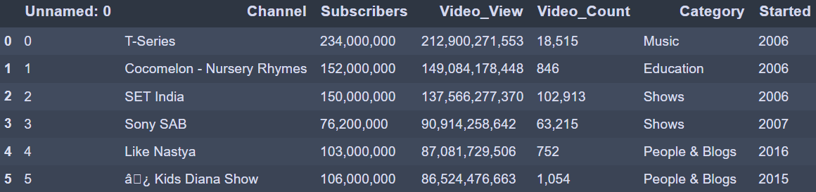
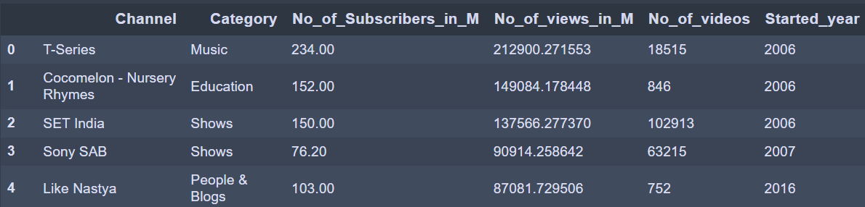
Raw data:
CLEANED DATA

Slide 6
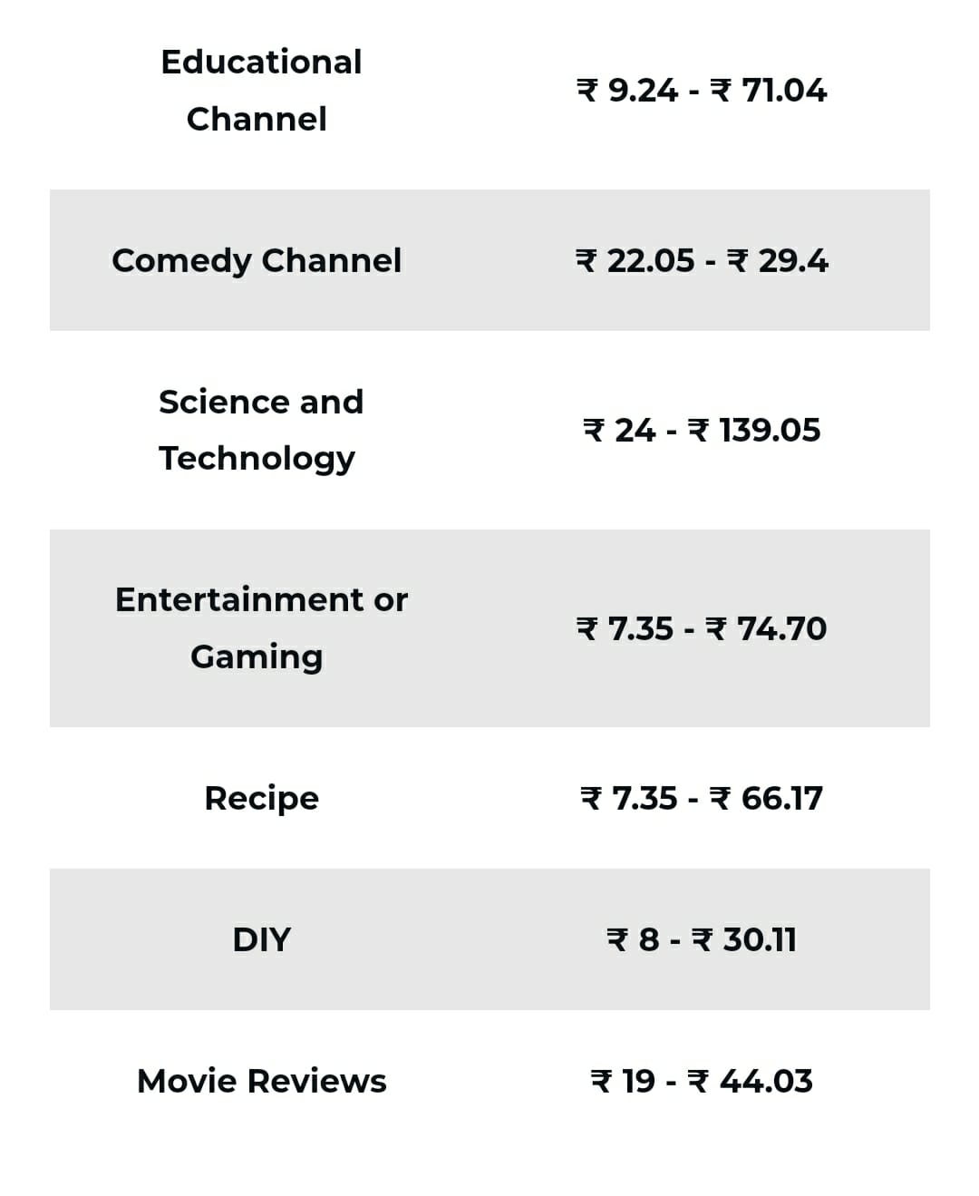
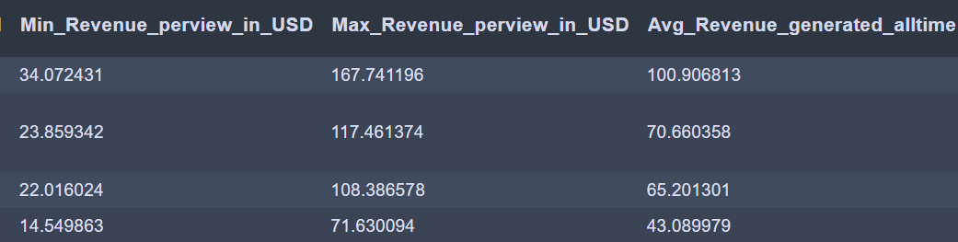
Getting sufficient data
Need to create columns for Revenue
With Reference to Category :
YouTube money is generated with reference to Views
minimum of Rs 13 for 1000 views means 0.013 rupees per
one view
In Case of maximum revenue for views average is around
64 rupees around 0.064 rupees per view
We have converted units of subscribes and views in to
millions and Revenue to million dollar’s
last column with over all income of channel

Slide 7

Play button
YouTube silver play button (100,000 subscribers)
YouTube gold play button (1 million subscribers)
YouTube diamond play button (10 million subscribers)
YouTube red diamond play button (100 million subscribers)
The Custom Creator award or custom play button is awarded to channels that gain a following of 50 million subscribers.

Slide 8
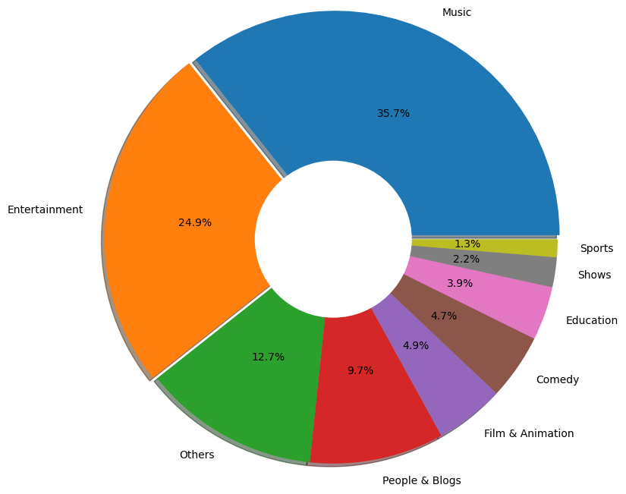
Percentage of Category with Respect to channels
Most of the channels use Music as there category with 35.7% and tops in the YouTube List
Entertainment category takes the second place with : 24.9%
Others :include (Gamming, how to style, news and style, news& style, news and technology, movies)

Slide 9
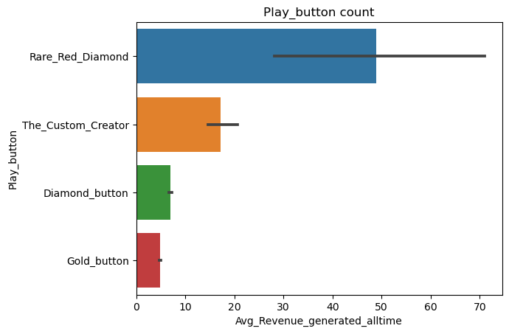
Play button vs Revenue
When we relate play button with Revenue
Red Diamond generates huge amount of Revenue than any other play button
Second highest is for The custom creator

Slide 10
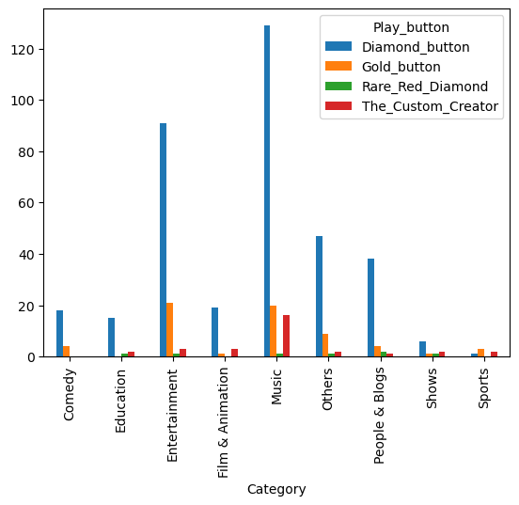
Count of play button with respect to Category
We can conclude that music had
been toped in almost every list
followed by Entertainment others and people & blog
where others include: (Gamming, how to style, news and style, news& style, news and technology, movies)

Slide 11
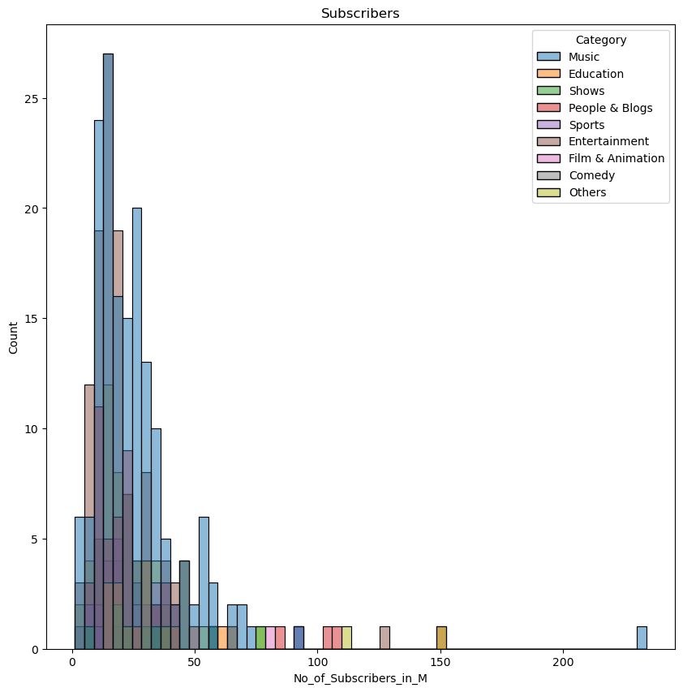
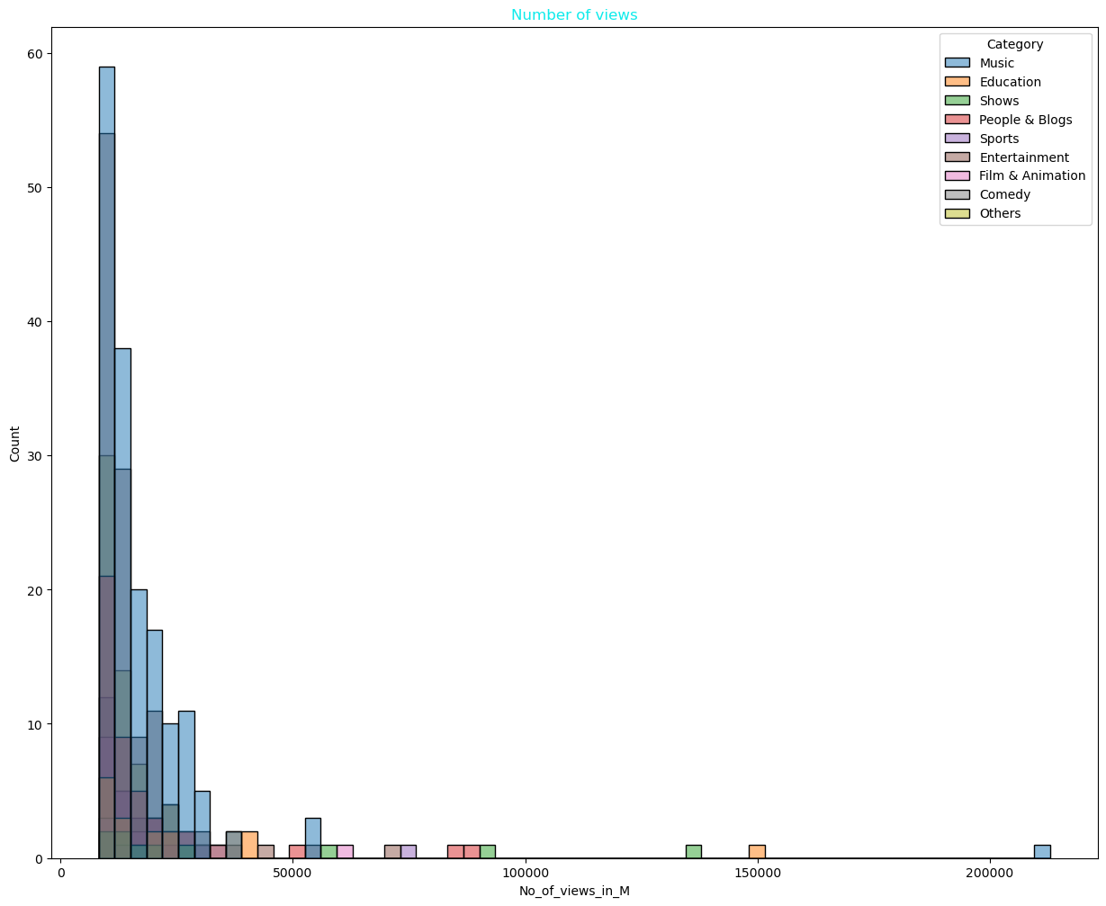
As per the plot No of subscribes
Are more in
Music
Education
Entertainment
As per no of views
Music
Education
Shows
These three category makes on Top

Slide 12
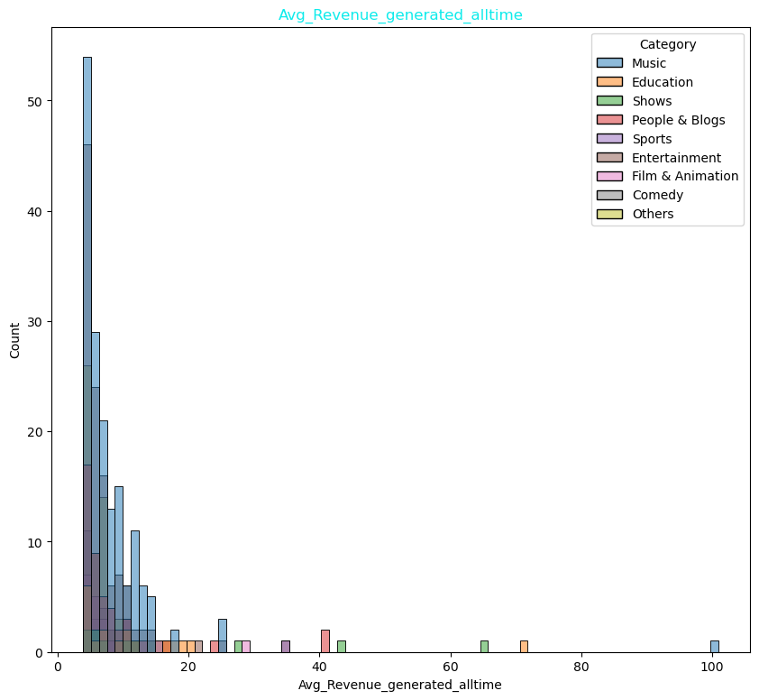
Revenue
As per the Average Revenue Generated all time .
Top List
1.Music
2.Education
3.Shows
as good income more 50 m used

Slide 13
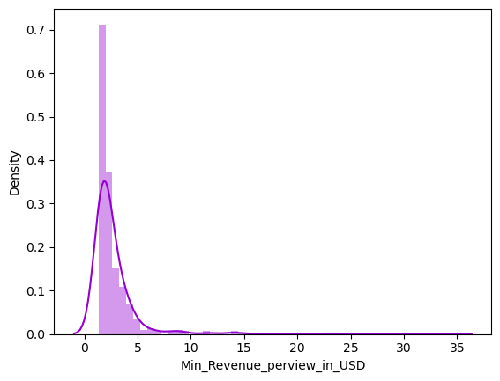
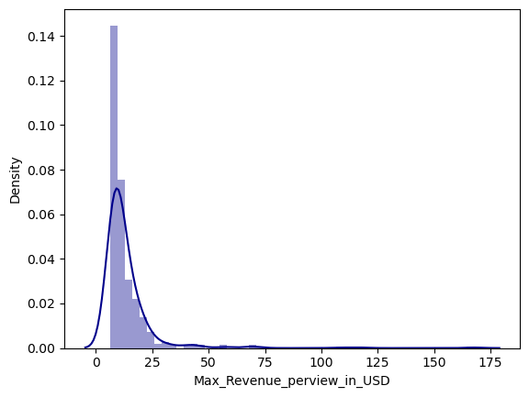
Finding the density of minimum & maximum Revenue
Minimum Revenue will be at least 2 million to 5 million
Maximum Revenue will be between 10 million to 20 million

Slide 14
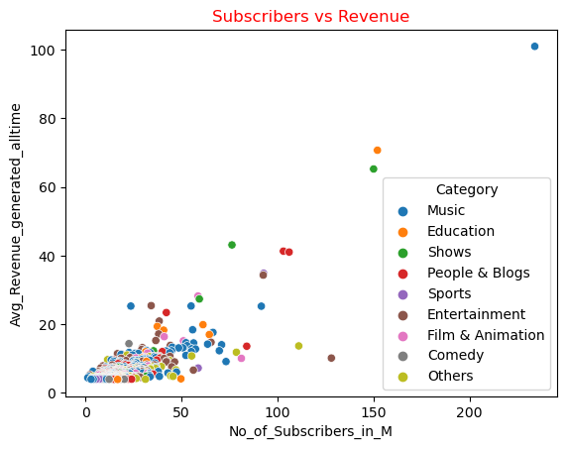
The Relation between Subscribers and total Revenue of Channel
As we plot a scatter plot between subscribers and Revenue.
we can see that in some cases we found that even after increase in the subscribers the Revenue may not increase parallel to the Revenue
There would be slight variation.

Slide 15
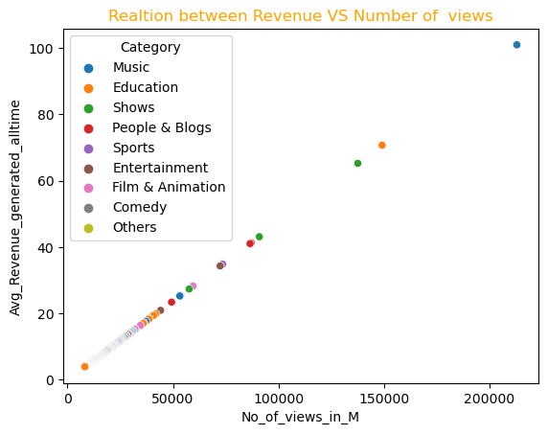
The Relation between Number of views and Total Revenue of Channel
Relation between Views and Revenue is directly proportional
we can relate that as views increase the Revenue increases

Slide 16
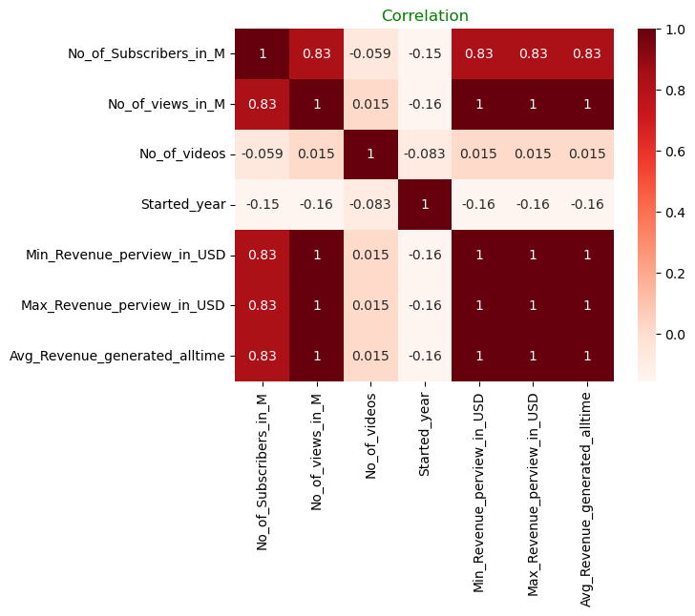
Heat map for correlation

Slide 17
CONCLUSION:
As per our brief visualization on data:
Most of the channels use Music and Entertainment and people & blogs as there Category
But as per no of subscribes: Music ,Education ,Entertainment tops the list
But as per no of views :Music Education shows are at top
conclusion as per Over all Revenue Generated by Views
The music category as the highest Revenue
Followed by Education and shows

Slide 18

Brightest of souls are born from darkest Nights….

